Slide 1

Introduction to ML strategy
Orthogonalization
deeplearning.ai

Slide 2
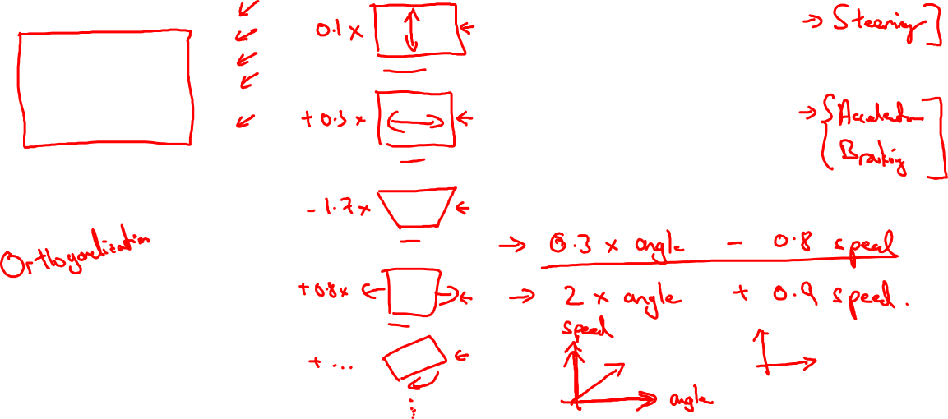
TV tuning example
Car

Slide 3
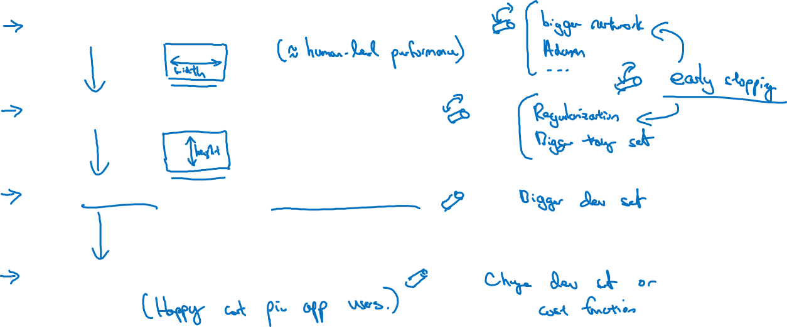
Chain of assumptions in ML
Fit training set well on cost function
Fit dev set well on cost function
Fit test set well on cost function
Performs well in real world

